Slide 1
Agenda
Guadalupe County Hospital - Meeting #2
Tuesday March 13, 2012
4:00 pm
Introductions – Christina Campos, CEO, Guadalupe County Hospital
Review of Meeting #1 – Val Schott, National Center
Guadalupe County Economic and Demographic Data - Gerald Doeksen, National Center
Guadalupe County Health Indicator/Health Outcome Data – Gerald Doeksen
Collect Completed Health Survey Questionnaires – Val Schott
Next Steps
Meeting #3, Tuesday April 10, 2012 at 4:00 p.m.

Slide 2
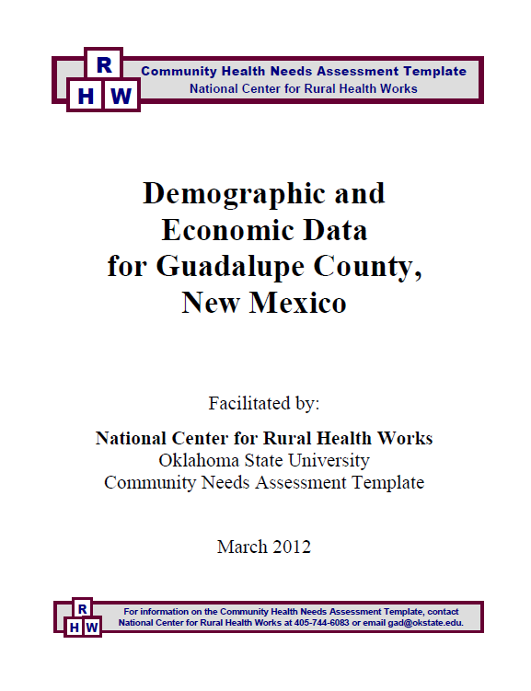

Slide 3
Table 2
Populations by Race and Hispanic Origin
for Guadalupe County and the State of New Mexico
 | White | Black | Native American¹ | Other² | Two or More Races³ | Total | Hispanic Origin⁴
2000 Census
Santa Rosa City | 1,577 | 60 | 48 | 934 | 125 | 2,744 | 2,227
Rural Area | 669 | 2 | 3 | 684 | 39 | 1,397 | 1,105
Guadalupe County | 2,530 | 62 | 53 | 1,855 | 180 | 4,680 | 3,801
Percent | 54.1% | 1.3% | 1.1% | 39.6% | 3.8% | 100.0% | 81.2%
State of New Mexico | 1,214,253 | 34,343 | 173,483 | 330,640 | 66,327 | 1,819,046 | 765,386
Percent | 66.8% | 1.9% | 9.5% | 18.2% | 3.6% | 100.0% | 42.1%
2010 Census
Santa Rosa City | 1,971 | 68 | 57 | 654 | 98 | 2,848 | 2,262
Rural Area | 694 | 3 | 13 | 174 | 32 | 916 | 677
Guadalupe County | 3,298 | 79 | 90 | 1,066 | 154 | 4,687 | 3,730
Percent | 70.4% | 1.7% | 1.9% | 22.7% | 3.3% | 100.0% | 79.6%
State of New Mexico | 1,407,876 | 42,550 | 193,222 | 338,521 | 77,010 | 2,059,179 | 953,403
Percent | 68.4% | 2.1% | 9.4% | 16.4% | 3.7% | 100.0% | 46.3%

Slide 4
Table 3
Populations by Age Group
for Guadalupe County and the State of New Mexico
 | Age Groups
 | 0-14 | 15-19 | 20-24 | 25-44 | 45-64 | 65+ | Total
2000 Census
Santa Rosa City | 505 | 211 | 205 | 944 | 549 | 330 | 2,744
Rural Area | 288 | 114 | 69 | 360 | 338 | 228 | 1,397
Guadalupe County | 908 | 365 | 298 | 1,437 | 1,024 | 648 | 4,680
Percent | 19.4% | 7.8% | 6.4% | 30.7% | 21.9% | 13.8% | 100.0%
State of New Mexico | 419,108 | 145,751 | 121,291 | 516,100 | 404,571 | 212,225 | 1,819,046
Percent | 23.0% | 8.0% | 6.7% | 28.4% | 22.2% | 11.7% | 100.0%
2010 Census
Santa Rosa City | 483 | 168 | 202 | 886 | 743 | 366 | 2,848
Rural Area | 170 | 53 | 42 | 166 | 343 | 142 | 916
Guadalupe County | 836 | 287 | 278 | 1,219 | 1,339 | 728 | 4,687
Percent | 17.8% | 6.1% | 5.9% | 26.0% | 28.6% | 15.5% | 100.0%
State of New Mexico | 429,980 | 149,861 | 142,370 | 515,768 | 548,945 | 272,255 | 2,059,179
Percent | 20.9% | 7.3% | 6.9% | 25.0% | 26.7% | 13.2% | 100.0%

Slide 5
Table 4
Population, Projections, and Percent Change
for Guadalupe County and the State of New Mexico
 | Census | Population Projections
 | 2010 | 2015 | 2020 | 2025 | 2030
Guadalupe County | 4,687 | 5,553 | 5,961 | 6,328 | 6,717
% Change from 2010 |  | 18.5% | 27.2% | 35.0% | 43.3%
State of New Mexico | 2,059,179 | 2,356,236 | 2,540,145 | 2,707,757 | 2,864,796
% Change from 2010 |  | 14.4% | 23.4% | 31.5% | 39.1%

Slide 6
Table 5
Full- & Part-Time Employment by Type of Employment & by Major Industry (NAICS)¹
for Guadalupe County and the State of New Mexico, 2009
 | Guadalupe County |  |  | New Mexico
 | No. of | % of | % of | % of | % of
 | Jobs | Total | Private | Total | Private
Total full- & part-time employment | 2,019 | 100.0% |  | 100.0%
Wage & salary employment | 1,439 | 71.3% |  | 79.1%
Proprietors' employment | 580 | 28.7% |  | 20.9%
Farm proprietors' employment | 217 | 37.4% |  | 7.8%
Nonfarm proprietors' employment² | 363 | 62.6% |  | 92.2%
By Industry:
Farm employment | 258 | 12.8% |  | 2.3%
Nonfarm employment | 1,761 | 87.2% |  | 97.7%
Private employment | 1,276 | 72.5% | 100.0% | 79.4% | 100.0%
Construction | 103 |  | 8.1% |  | 8.1%
Retail trade | 260 |  | 20.4% |  | 13.5%
Transportation & warehousing | 64 |  | 5.0% |  | 2.9%
Health care & social assistance | 156 |  | 12.2% |  | 14.2%
Accommodation & food services | 415 |  | 32.5% |  | 9.8%
Other services, except public admin | 73 |  | 5.7% |  | 6.2%
Sum of (D) and (L) Categories³ | 205 |  | 16.1%
Government & government enterprises | 485 | 27.5% |  | 20.6%

Slide 7
Table 6
Personal Income Earnings by Place of Work and by Industry (NAICS)¹
for Guadalupe County and the State of New Mexico, 2009
 | Guadalupe County |  |  | New Mexico
 | Income | % of | % of | % of | % of
 | ($1,000s) | Total | Private | Total | Private
Total earnings by place of work | 58,321 | 100.0% |  | 100.0%
Wage & salary disbursements | 38,422 | 65.9% |  | 71.6%
Proprietors' income² | 9,299 | 15.9% |  | 9.9%
All other earnings | 10,600 | 18.2% |  | 18.6%
Earnings by Industry
Total earnings by industry | 58,321 | 100.0% |  | 100.0%
Farm earnings | 5,650 | 9.7% |  | 1.2%
Nonfarm earnings | 52,671 | 90.3% |  | 98.8%
Private earnings | 32,819 | 62.3% | 100.0% | 71.6% | 100.0%
Construction | 4,128 |  | 12.6% |  | 8.6%
Retail trade | 6,188 |  | 18.9% |  | 9.7%
Transportation & warehousing | 2,136 |  | 6.5% |  | 3.7%
Educational services | 64 |  | 0.2% |  | 1.2%
Health care & social assistance | 6,405 |  | 19.5% |  | 15.7%
Other services, except public admin | 2,818 |  | 8.6% |  | 5.2%
Sum of (D) & (L) Categories³ | 3,679 |  | 11.2%
Government & government enterprises | 19,852 | 37.7% |  | 28.4%

Slide 8
Table 7
Transfer Receipts for Guadalupe County and the State of New Mexico, 2009
 | Guadalupe County |  | State of New Mexico
 | Receipts* | % of | Receipts* | % of
 | ($1,000s) | Total | ($1,000s) | Total
Total personal current transfer receipts | 44,879 | 100.0% | 14,345,809 | 100.0%
Receipts of individuals from govts | 44,106 | 98.3% | 13,981,149 | 97.5%
Ret. & disab. ins. benefits | 10,445 | 23.3% | 4,313,600 | 30.1%
Old-age, surv & disab ins benefits | 9,835 | 21.9% | 4,165,644 | 29.0%
Railroad ret & disab benefits | 556 | 1.2% | 86,408 | 0.6%
Workers' comp | (L) | ** | 55,809 | 0.4%
Other govt ret & disab ins benefits¹ | (L) | ** | 5,739 | 0.0%
Medical benefits | 24,494 | 54.6% | 6,225,189 | 43.4%
Medicare benefits | 8,683 | 19.3% | 2,623,849 | 18.3%
Public asst medical care benefits² | 15,761 | 35.1% | 3,524,253 | 24.6%
Military medical insurance benefits³ | 50 | 0.1% | 77,087 | 0.5%

Slide 9
Table 8
Economic Indicators
for Guadalupe County and the State of New Mexico
 | Guadalupe | State of
Indicator | County | New Mexico
Total Personal Income (2009) | 105,946,000 | 66,856,080,000
Per Capita Income (2009) | 24,981 | 33,267
Employment (2010) | 1,618 | 873,112
Unemployment (2010) | 187 | 80,202
Unemployment Rate (2010) | 10.4% | 8.4%
Employment (2011) | 1,592 | 873,656
Unemployment (2011) | 178 | 67,227
Unemployment Rate (2011) | 10.0% | 7.1%
% of People in Poverty (2010) | 23.7% | 19.8%
% of Under 18 in Poverty (2010) | 30.5% | 28.5%
Transfer Receipt Dollars (2009) | 44,879,000 | 14,345,809,000
Transfer Dollars as Percentage of | 42.4% | 21.5%
Total Personal Income (2009)

Slide 10
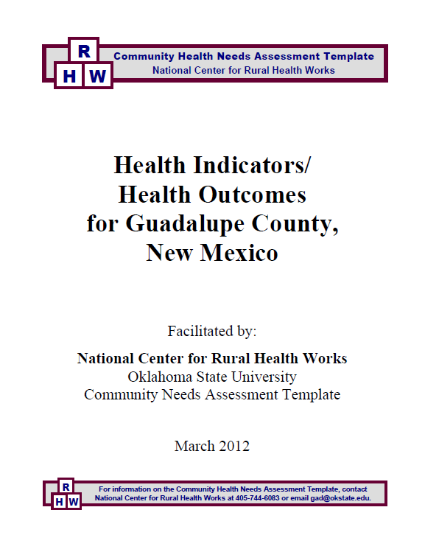

Slide 11
Table 1
 | Guadalupe County | State of New Mexico
Health Factors
Health Behaviors
Adult obesity - BMI ≥ 30 | 23.0% | 27.0%
Teen birth rate - ages 15-19 | 62 | 64
Clinical Care
Uninsured adults - under age 65 | 26.0% | 30.0%
Diabetic screening - Diabetic Medicare enrollees | 83.0% | 70.0%
Children in Poverty-Under 18 in Poverty | 31.0% | 24.0%

Slide 12
Table 2
Access to Care
for Guadalupe County, New Mexico
ACCESS TO CARE
Guadalupe Co., NM
In addition to use of services, access to care may be characterized by medical care coverage and service availability.
Uninsured individuals (age under 65) | 839
Medicare beneficiaries²
Elderly (age 65+) | 662
Disabled | 199
Medicaid beneficiaries | 1,417
Primary care physicians per 100,000 population | 69
Dentists per 100,000 population | 0
Community/Migrant Health Centers | Yes
Health Professional Shortage Area | Yes

Slide 13
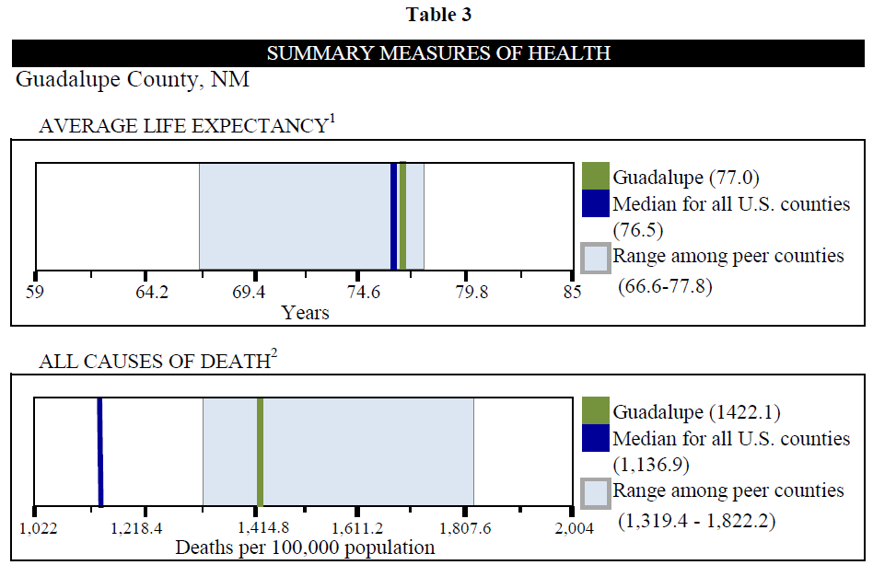

Slide 14
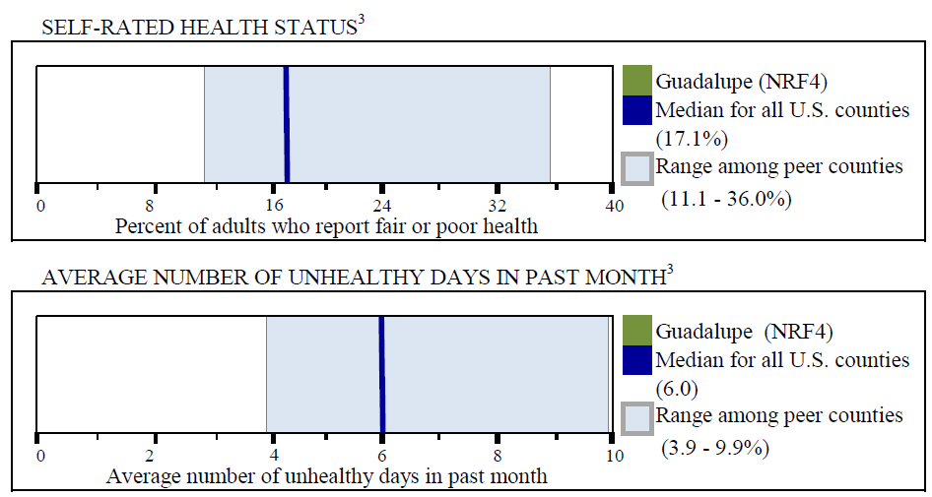
Continued
Guadalupe County, NM

Slide 15
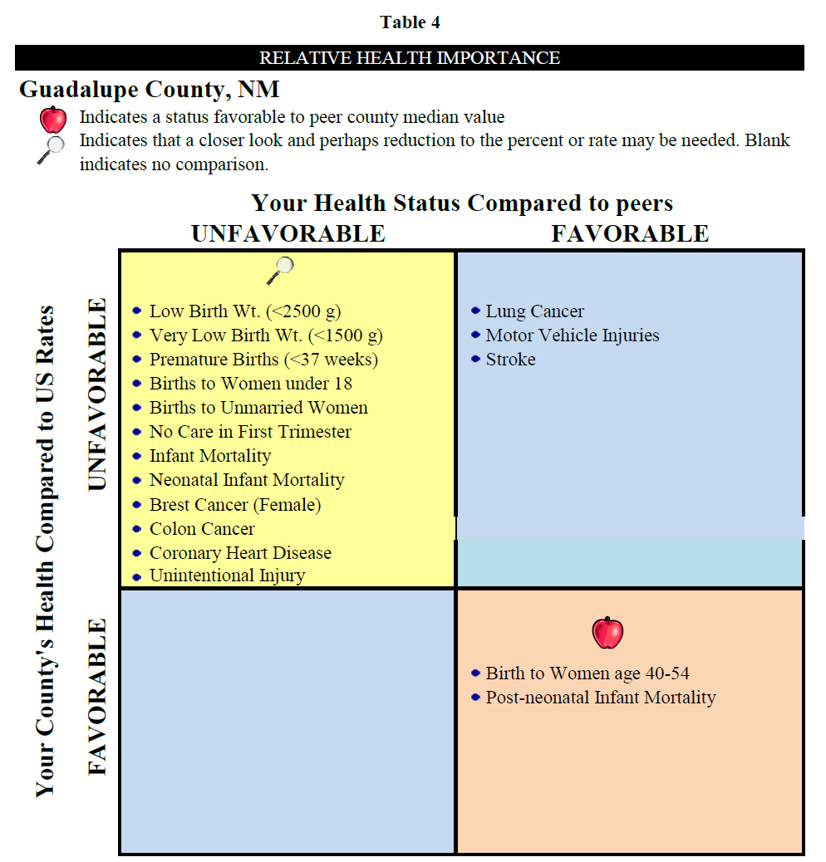

Slide 16
Table 7
Births by Race
for Guadalupe County and the State of New Mexico
 | Guadalupe County |  | New Mexico
 | 2009 |  | 2009
 | No. | % | No. | %
White | 2 | 5.6% | 8,186 | 28.4%
Black | 0 | 0.0% | 616 | 2.1%
Hispanic | 34 | 94.4% | 15,328 | 53.1%
Other¹ | 0 | 0.0% | 4,558 | 15.8%
Unknown/Not Reported | 0 | 0.0% | 185 | 0.6%
Total Births | 36 | 100.0% | 28,873 | 100.0%

Slide 17
Table 8
Birth's by Mother's Age
for Guadalupe County and the State of New Mexico
 | Guadalupe County |  | State of New Mexico
 | 2009 |  | 2009
Age Groups | No. | % | No. | %
10-17 | 2 | 5.6% | 1,531 | 5.3%
18-19 | 2 | 5.6% | 2,930 | 10.1%
20-29 | 22 | 61.1% | 16,580 | 57.4%
30-39 | 10 | 27.8% | 7,231 | 25.0%
40-49 | 0 | 0.0% | 597 | 2.1%
50+¹ | 0 | 0.0% | 3 | 0.0%
Unknown/ Not Reported | 0 | 0.0% | 4 | 0.0%
Total Births | 36 | 100.0% | 28,873 | 100.0%

Slide 18
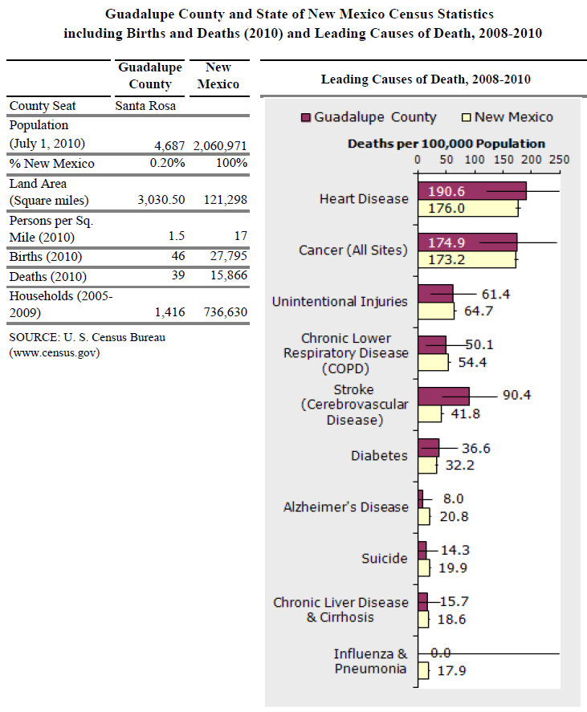

Slide 19
Table 16
Health Characteristics From Community Health Highlights
for Guadalupe County and the State of New Mexico
Health Characteristic | Guadalupe County | New Mexico | Comparison to State
Youth Smoking Prevalence (2009) | 19.9 | 24 | Watch
Adolescent Physical Activity (2007) | 50.8 | 43.6 | Watch
% of Adolescents who ate 5+ Servings of Fruits and Veggies Daily (2003-2009) | 19.6 | 20.9 | Improvement Needed
Youth (Grades 9-12) with Caring and Supportive Relationship in the Family (2009) | 72.7 | 54.1 | Excellent
Alcohol-Related Deaths per 100,000 Population (2007-2009) | 101.8 | 52.9 | Improvement Needed

Slide 20
Table 16 Continued
Health Characteristics From Community Health Highlights
for Guadalupe County and the State of New Mexico
Alcohol-Related Chronic Disease Deaths per 100,000 Population (2007-2009) | 69.5 | 23.9 | Improvement Needed
Alcohol Related Injury Death Rates per 100,000 Population (2007-2009) | 32.2 | 29.0 | Improvement Needed
Drug-Induced Deaths per 100,000 Population (2007-2009) | 27.1 | 22.8 | Improvement Needed
Health Insurance Coverage; % Uninsured, Under 65 Years (2009) | 30.6 | 22.9 | Reason for Concern
Medicaid Enrollment; Avg Monthly % of Population (2010) | 26.9 | 23.4 | NA
Primary Care Providers; Ratio of Population to Providers (2008) | 1440 | 832 | NA
Prenatal Care in First Trimester (2008-2009) | 68.2 | 52.0 | Excellent

Slide 21
Table 16 Continued
Health Characteristics From Community Health Highlights
for Guadalupe County and the State of New Mexico
% of Live Born Infants with Low Birthweight (2008-2010) | 12.7 | 8.5 | Improvement Needed
Teen Birth Rate; Births per 1000 Girls Age 15-17 (2007-2009) | 21.3 | 31.6 | Watch
Chlamydia Cases per 100,000 Population (2010) | 666.7 | 557.9 | NA
Diseases of the Heart Death Rate per 100,000 population (2007-2009) | 384.4 | 203.8 | Reason for Concern
Stroke Death Rate per 100,000 population (2005-2009) | 73 | 38.2 | Improvement Needed
Diabetes Deaths per 100,000 population (2008-2010) | 32.5 | 32.5 | Watch

Slide 22
Table 16 Continued
Health Characteristics From Community Health Highlights
for Guadalupe County and the State of New Mexico
Adolescent Obesity (BMI ≥ 95th percentile) (2001-2009) | 18.7 | 13.5 | Reason for Concern
Female Breast Cancer Deaths per 100,000 population (2001-2005) | 62 | 22.1 | Improvement Needed
Influenza and Pneumonia Deaths per 100,000 Population (2006-2009) | 10.8 | 20.6 | Watch
Unintentional Injury Death Rates per 100,000 population (2003-2007) | 88.6 | 62.3 | Improvement Needed
Motor Vehicle Traffic Crash Deaths per 100,000 population (2005-2009) | 31 | 18.3 | Improvement Needed
Suicide Death Rates per 100,000 population (2007-2009) | 12.9 | 18.6 | Watch

Slide 23
Table 16 Continued
Health Characteristics From Community Health Highlights
for Guadalupe County and the State of New Mexico
Ratio of Total Substantiated Child Abuse Allegations per 1000 child population (2010) | 39.4 | 18.5 | Improvement Needed
% of Youth Who Felt Sad or Hopeless Almost Every day (2001-2009) | 28.9 | 29.7 | Watch
Life Expectancy from Age 65 in avg. number of years (2005-2009) | 17.89 | 18.7 | NA
Children (Under Age 18) Living in Poverty (2009) | 32 | 28.8 | Improvement Needed
High School Graduation Rate (2010) | 84.7 | 67.3 | Excellent

Slide 24
Agenda
Guadalupe County Hospital - Meeting #2
Tuesday March 13, 2012
4:00 pm
Introductions – Christina Campos, CEO, Guadalupe County Hospital
Review Prior Two Meetings– Val Schott, National Center
Health Survey Results - Gerald Doeksen, National Center
Develop Community Action Plan – Val Schott and Gerald Doeksen
List Community Health Issues
Prioritize Community Health Issues
Discuss Possible Resolution for Health Issues
Summarize Community Recommendations
Hospital CEO Response- Christina Campos
Next Steps
R
Community Health Needs Assessment Template
H
W
National Center for Rural Health Works

Slide 25
For Additional Information:
Please contact:
Gerald Doeksen, Executive Director
Email: gad@okstate.edu
Phone: 405-744-6083
or
Cheryl F. St. Clair, Associate Director
Email: cheryl@okstate.edu
Phone: 405-744-6083 or 98245
National Center for Rural Health Works
Oklahoma State University
R
Community Health Needs Assessment Template
H
W
National Center for Rural Health Works

